Slide 1
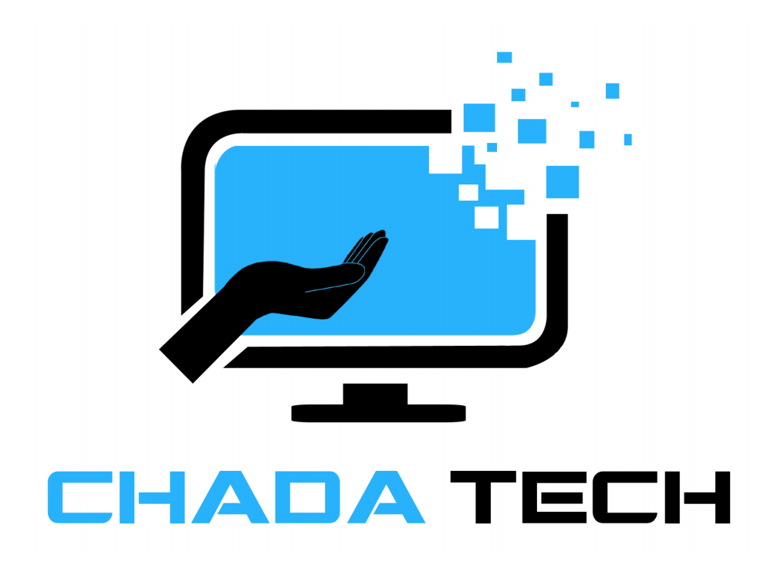
The Scrum-Agile Approach
The SNHU Travel Experience
Presenter: Jeff Levine

Slide 2
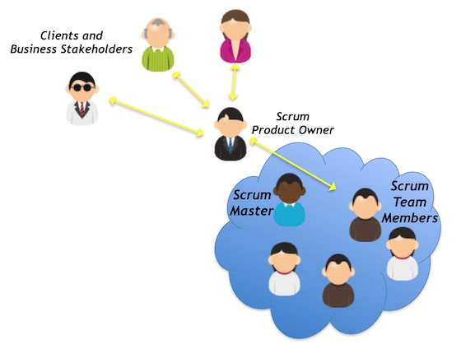
The Scrum Team – Who’s who?
Product Owner: The voice of the customer and business. They are responsible for defining and prioritizing the Product Backlog to maximize the value of the product. They make the final decisions on what gets built.
Scrum Master: A facilitator who coaches the team and removes impediments. They ensure the team follows Scrum principles and processes, directs meetings, and protects the team from distractions.
Development Team: The developers, designers, and testers who build the product. Collectively responsible for providing incremental deliverables for each sprint.

Slide 3
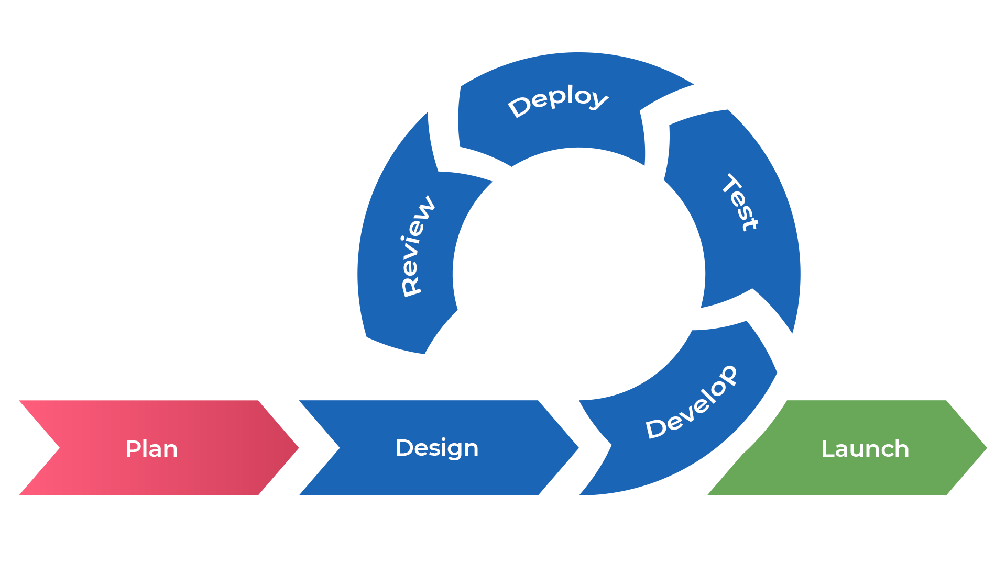
The Agile SDLC: An Iterative and Incremental Approach
Unlike traditional models, Agile treats the SDLC as a continuous cycle of short iterations called Sprints.
Planning: At the start of a sprint, the team collaborates to select user stories from the Product Backlog and defines what can be completed in the sprint.
Execution: The team works on the selected user stories, with daily check-ins (Daily Scrums) to track progress and address blockers.
Review & Retrospective: At the end of the sprint, the team demonstrates the finished work to stakeholders (Sprint Review) and then reflects on how to improve the process for the next sprint (Sprint Retrospective).

Slide 4
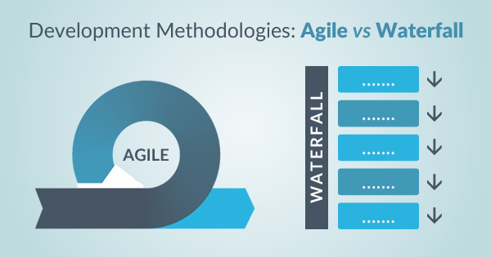
Waterfall vs. Agile
The Waterfall model is a linear, sequential approach where each phase must be completed before the next one begins.
Waterfall Approach: In a Waterfall model, a change in requirements after the initial design phase (e.g., getting a new wireframe) would be a major, costly disruption. The entire project would likely need to go through a formal change request process, leading to a re-evaluation of the entire project plan, new documentation, and significant delays.
With our SNHU Travel project, the new wireframe was handled smoothly. The change was identified by the Tester, discussed with the Product Owner, and incorporated into a future sprint's plan. This was done without stopping the current sprint's work, proving the flexibility of Agile.

Slide 5
What to choose?
The choice between Waterfall and Agile depends on several key factors:
Requirement Clarity: Waterfall is best when requirements are extremely stable and well-defined from the start. Agile is better for projects where requirements are likely to change or are initially unclear, like with our SNHU Travel project.
Customer Involvement: Agile requires and thrives on high customer and stakeholder involvement throughout the process. Waterfall typically involves the customer at the beginning and the end.
Project Size and Complexity: Waterfall is sometimes used for small, simple projects with clear scopes. Agile is highly effective for complex projects that require continuous feedback and adaptation to succeed.
Our experience shows that for a new, customer-facing product with evolving needs, the iterative and collaborative nature of Agile is a far superior approach to the rigid, linear nature of Waterfall.

Slide 6
References
Cobb, C G. (2015). The Project Manager’s Guide to Mastering Agile: Principles and Practices for an Adaptive Approach. Wiley.
Iordanidis, J. (2024, August 25). Daily Scrum: Best Practices and Pitfalls to Avoid. Agile Best Practices. https://www.easyagile.com/blog/daily-scrum
Iqbal, M. (2022, May 31). The Purpose of the Five Scrum Events. https://www.scrum.org/resources/blog/purpose-five-scrum-events
Blake, S (2021, December 8). Agile vs Waterfall: The Pros and Cons of Each Methodology. https://www.easyagile.com/blog/daily-scrum

